Slide 1
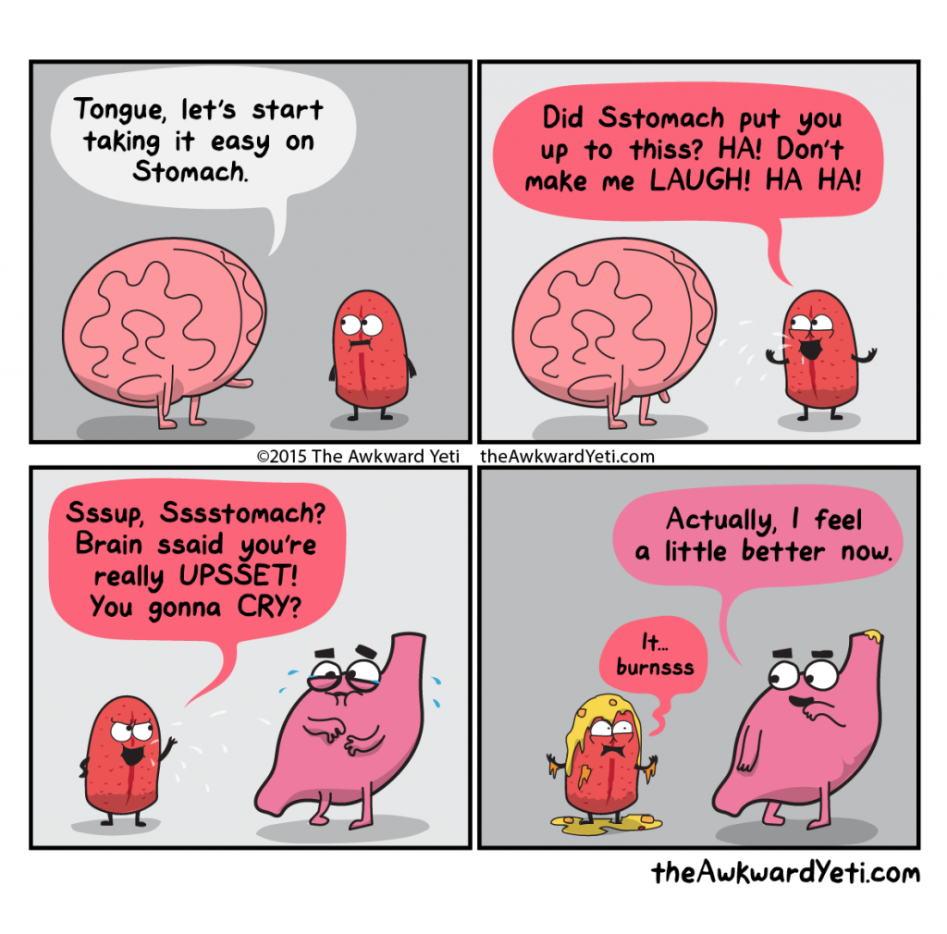
Digestion

Slide 2
Lesson Objectives:
Define Digestion
Distinguish between mechanical and chemical digestion
Define Enzymes and explain their role in digestion
Discover the parts of the digestive system

Slide 3

Digestion is the mechanical and chemical breakdown of food into smaller components that are more easily absorbed into the blood stream.

Slide 4
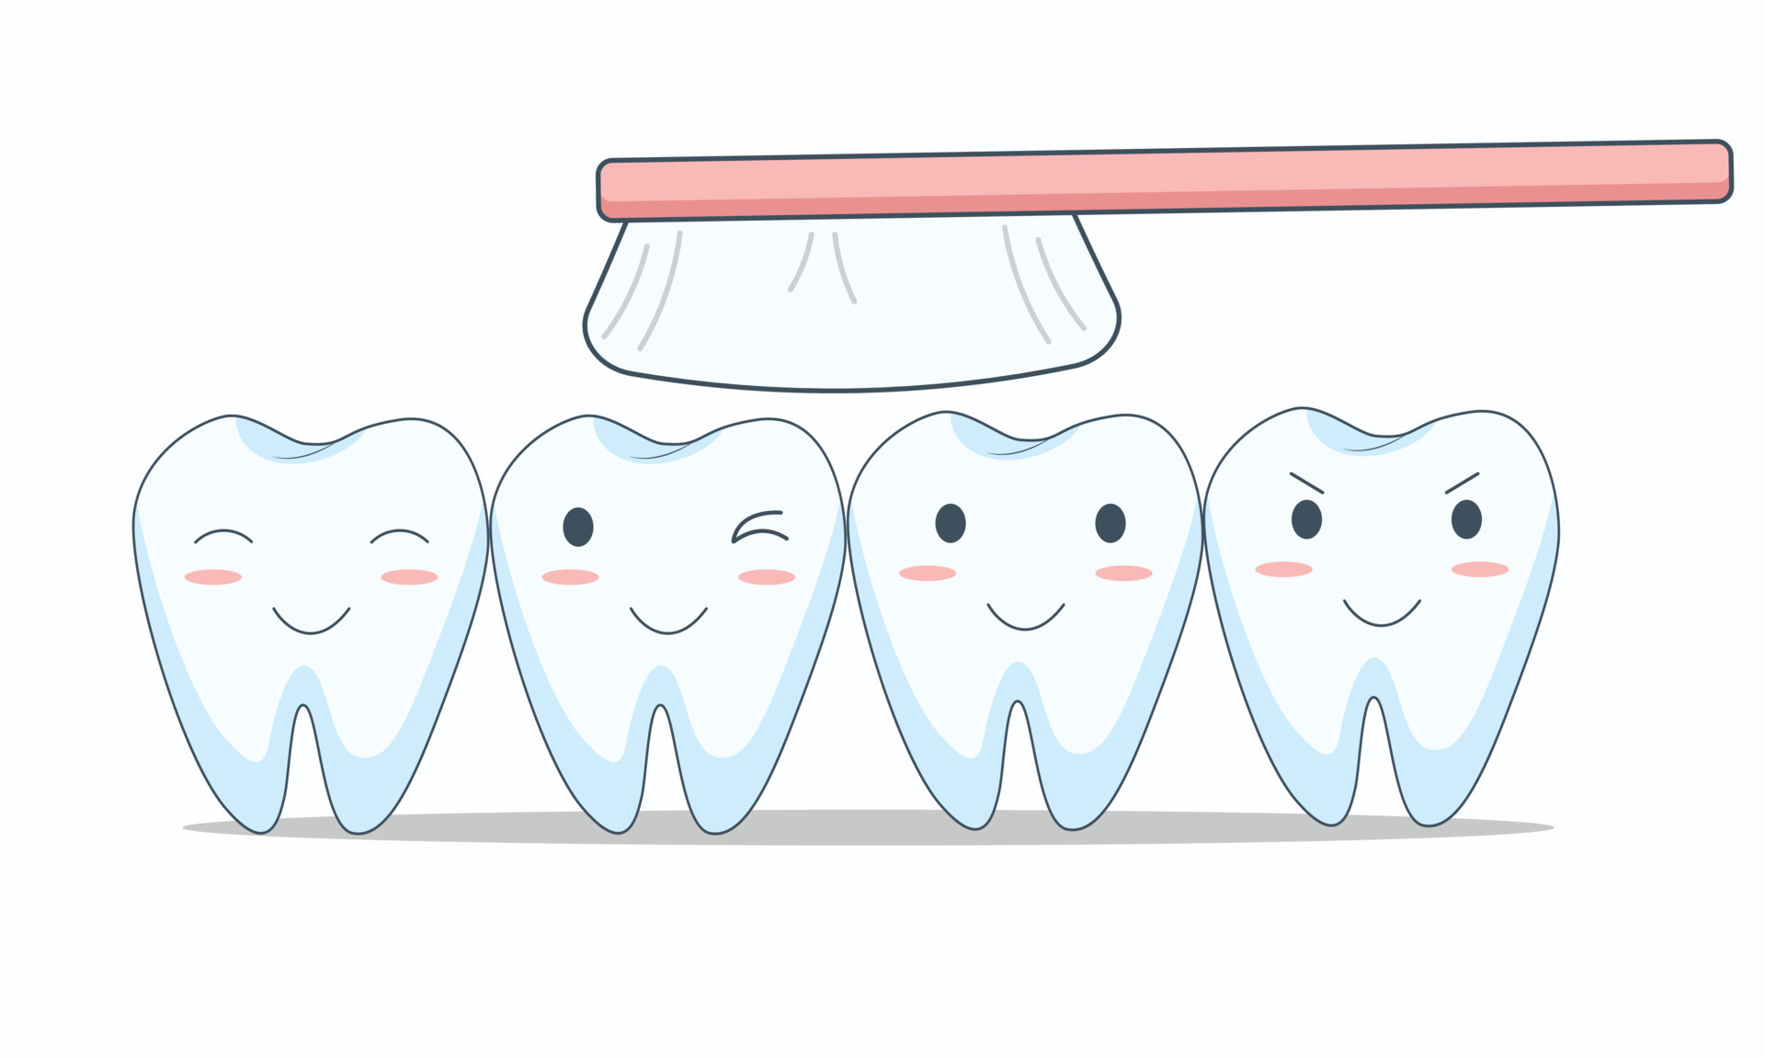
So what does the Mechanical Digestion involve?
It involves the teeth.

Slide 5
Teeth
In humans teeth are held firmly in place by the jaw.
They are used to cut tear and grind food breaking it down into smaller pieces.
This greatly increases the surface area of the food so that the enzymes can act on them (we will discuss enzymes later).

Slide 6

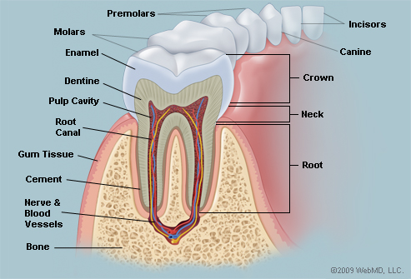
Section of a tooth showing parts.

Slide 7
Parts of the Tooth
The part of the tooth that can be seen is called the crown .
The crown is covered in enamel which is the hardest material in the human body.

Slide 8
Parts of the Tooth
The dentine found under the enamel is similar to bone in structure and is also hard. The central pulp cavity has nerves and blood vessels that contain cells that make dentine.
Dentine is less mineralized and less brittle than enamel, it is necessary for the support of the enamel.

Slide 9

What are some ways we take care of our teeth?

Slide 10
Teeth Care
If not properly cared for teeth can decay. Avoid sweet sticky foods these make acids that destroy enamel eventually exposing the pulp cavity which contains nerves that are sensitive to heat and cold and eventually cause tooth ache.

Slide 11
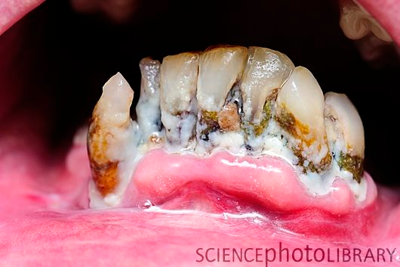

Slide 12
Proper care of teeth.
Regular dental visits
Brush at least twice per day
Eat crunchy foods that stimulate membrane blood activity.
Eat foods rich in calcium phosphorus and vitamin C and D
Fluorine in water.
Do not suck fingers.
Floss regularly this removes plaque and all foods between teeth.

Slide 13
Types of Teeth
There are four different types of teeth:
Incisors
Canines
Premolars
Molars.

Slide 14
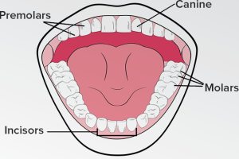

Slide 15
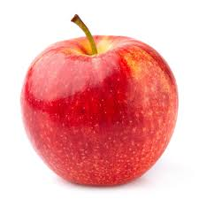
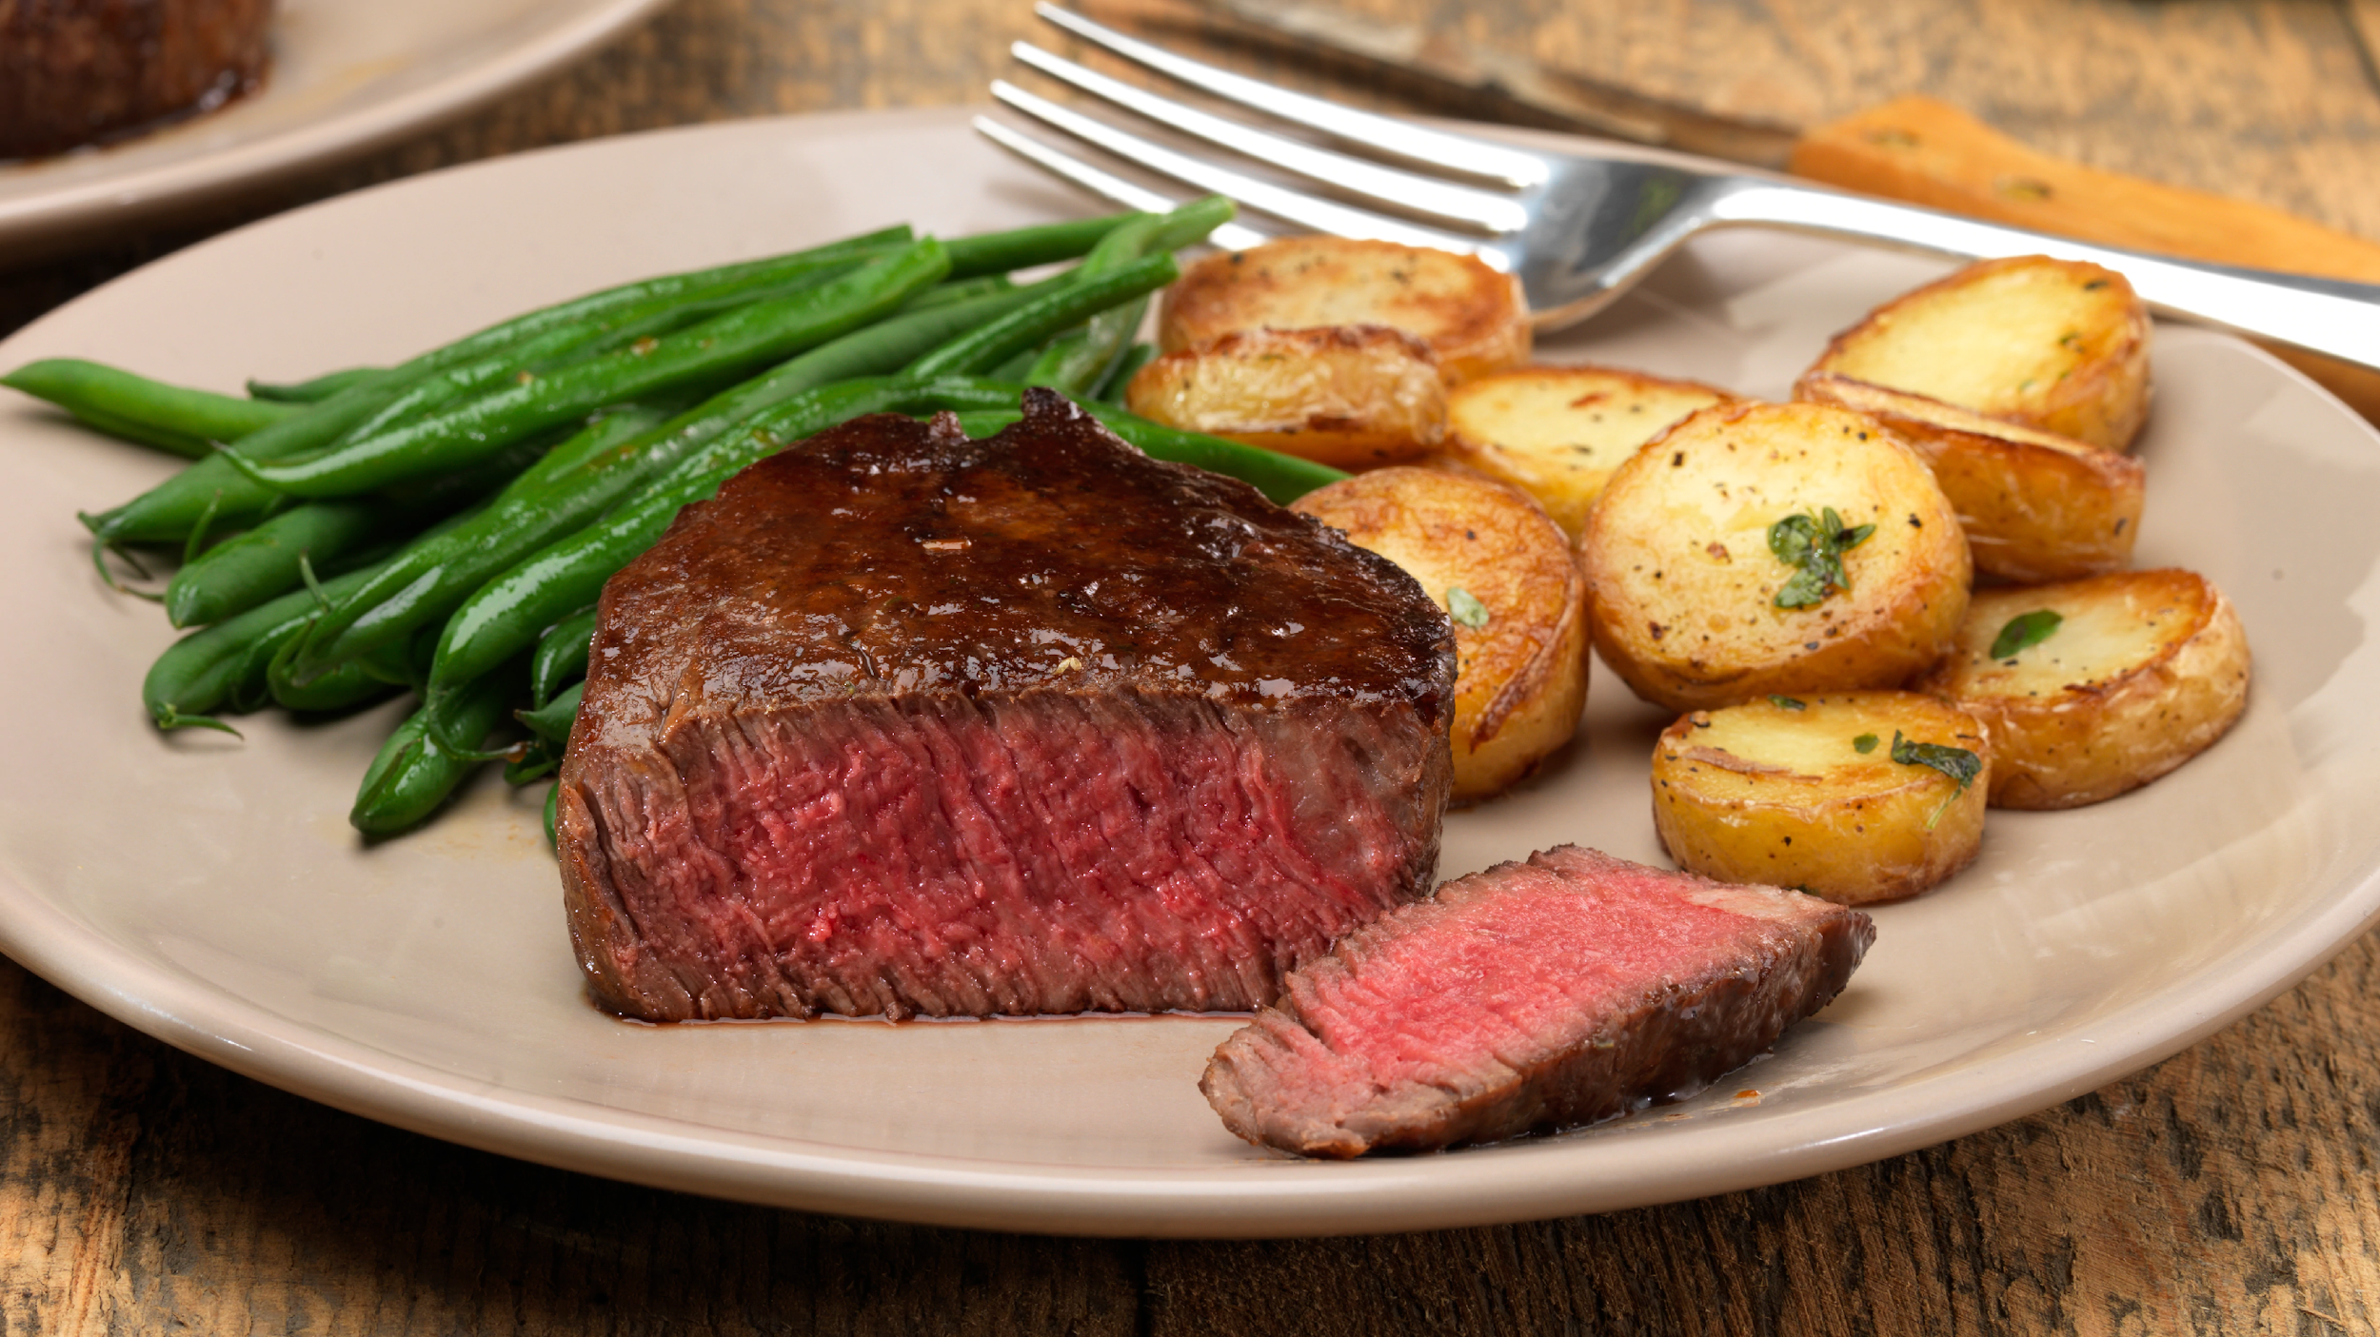
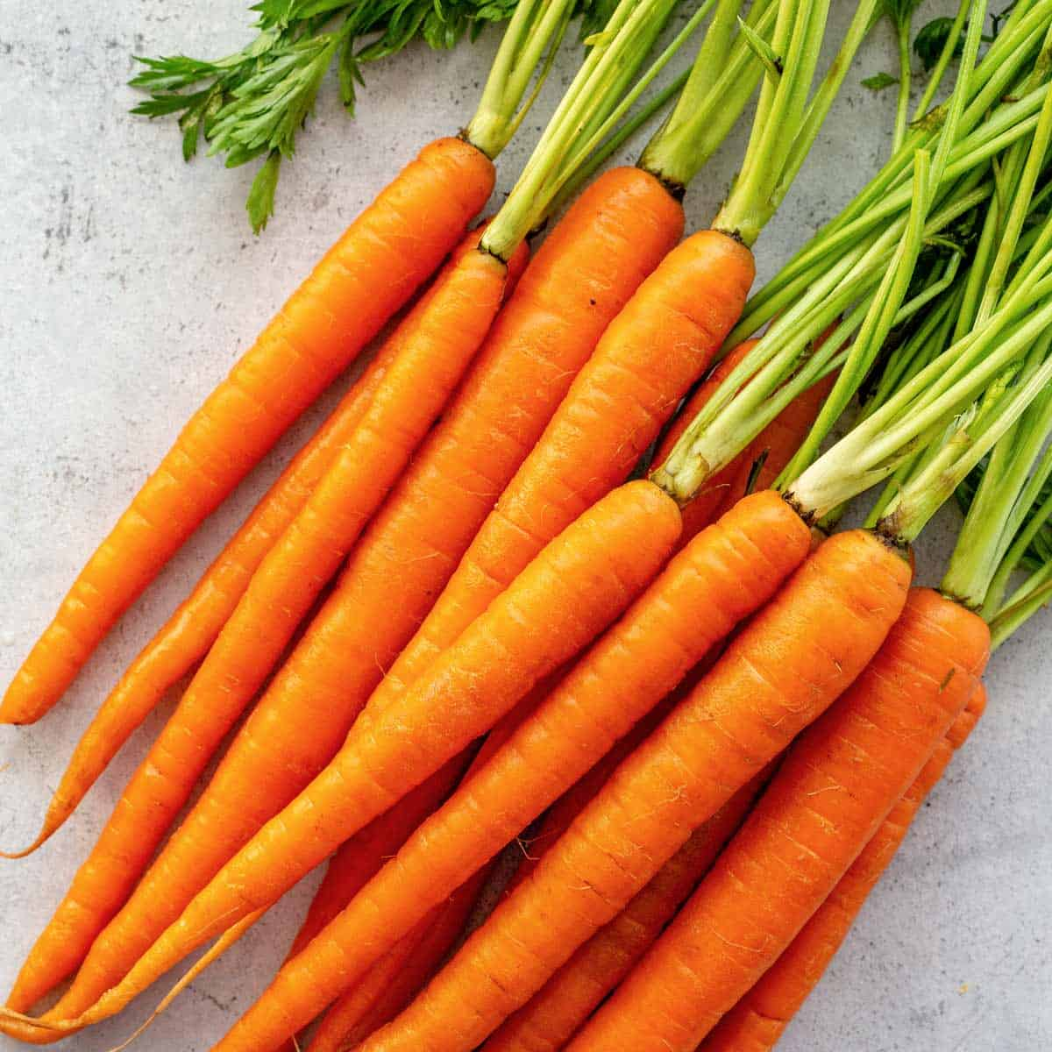
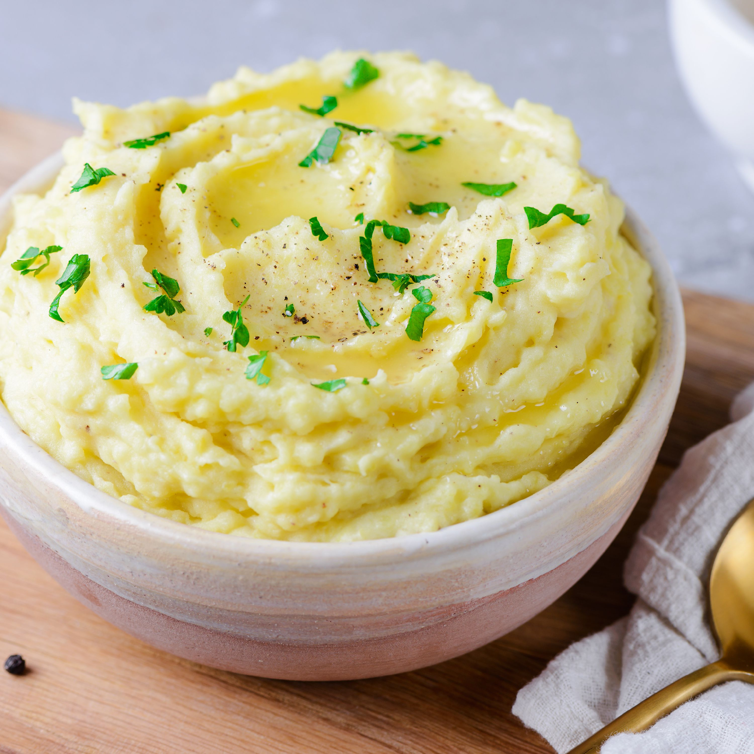
Which types of teeth are important to digest which foods below? (a.incisors, b.canines, c.premolars d.molars)
2.
3. 4.

Slide 16
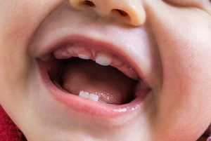
Types of Teeth
For man we have two sets of teeth there are the milk teeth or baby teeth and the permanent teeth.
Milk teeth start to appear from about 6 months and start falling out from about 6 years old. They consist of 8 incisors, 4 canines and 8 molars.
Permanent teeth replace the 20 lost milk teeth and an additional 12 develop. They consist of 8 incisors, 4 canines, 8 premolars and 12 molars.

Slide 17
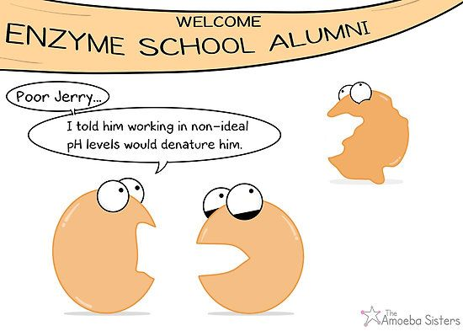
So what does the Chemical Digestion involve?
It involves the Enzymes.

Slide 18
Enzymes
Enzymes are complex proteins that change (speed up) the rate of a chemical reaction without being changed themselves. They speed up reactions.

Slide 19
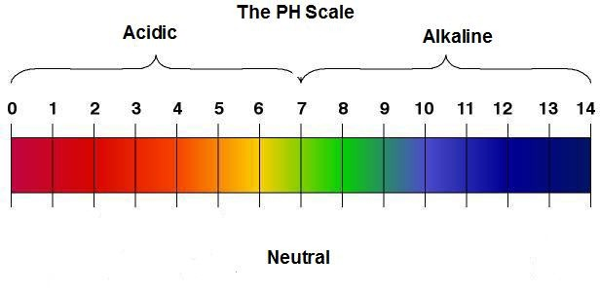
Properties of enzymes:
1. They work best at a particular pH, pH refers to acidity or alkalinity. pH is rated on a scale of one to fourteen. One to six is acid, seven is neutral and eight to fourteen is alkaline.

Slide 20
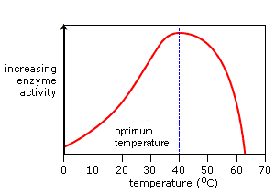
(2) They work best at a particular temperature. Too cold they become inactivated and too hot and they are denatured or destroyed.

Slide 21
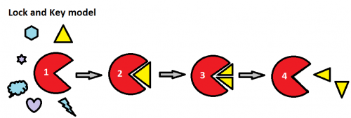
3. They are specific – Enzymes will only work on one particular substrate. Similar to a lock and key mechanism.

Slide 22
4. They break down large quantities of substrate. A little enzyme is needed to break down large quantities of substrate.
5. They are not chemically changed at the end of the reaction. As a result they can go on to react with more substrate.
6. They are sensitive to poisons.

Slide 23
State two properties of Digestive Enzymes?

Slide 24
Digestion and Enzyme Activity
We will look at the digestion of three macronutrients. These are Carbohydrates, Proteins and Fats.

Slide 25
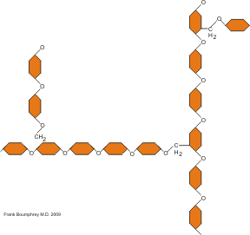
Carbohydrate Digestion:
As we learnt earlier carbohydrates can be classed as three molecules
Polysaccharides
Disaccharides
Monosaccharides
Most of the carbohydrate that we eat is in the polysaccharide form.
Polysaccharide chain-Many single sugar units together.

Slide 26
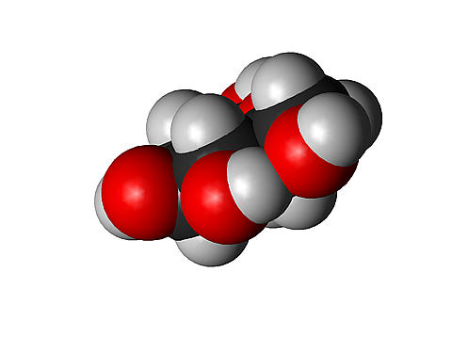
Polysaccharide chains must be converted to monosaccharide units so that they can be absorbed.
The main aim of digestion is to do this.
Polysaccharide unit
Monosaccharide unit

Slide 27
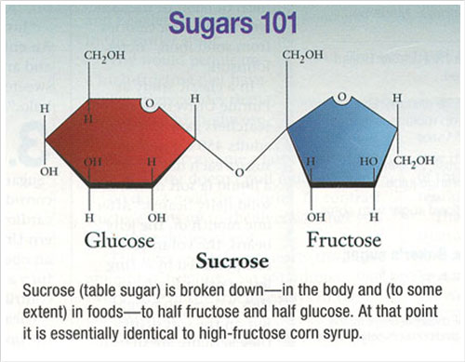
Digestion begins in the mouth:
The enzyme in saliva called Salivary Amylase takes starch, which is a polysaccharide and converts it to maltose which is a disaccharide unit. The pH of the mouth is neutral to slightly alkaline. Salivary amylase works best at these conditions, it is specific as such it will not work on protein or fats these are broken down by other enzymes at other parts of the digestive system.
Polysaccharide
Disaccharide
Starch
Maltose

Slide 28
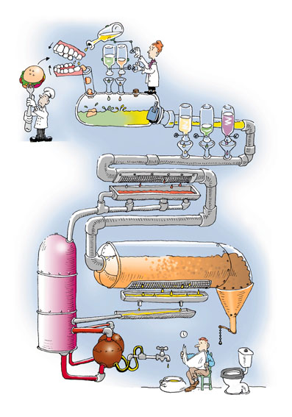
We will return to carbohydrate digestion later on

Slide 29
Protein Digestion
Food enters the stomach from the oesophagus. It is here that protein digestion begins. The stomach walls secrete gastric juices that have dilute hydrochloric acid and the enzymes pepsin and rennin. The pH of the stomach is acidic. As such salivary amylase will not work. Pepsin and rennin work best in acidic conditions, they are used to begin the digestion of protein.

Slide 30
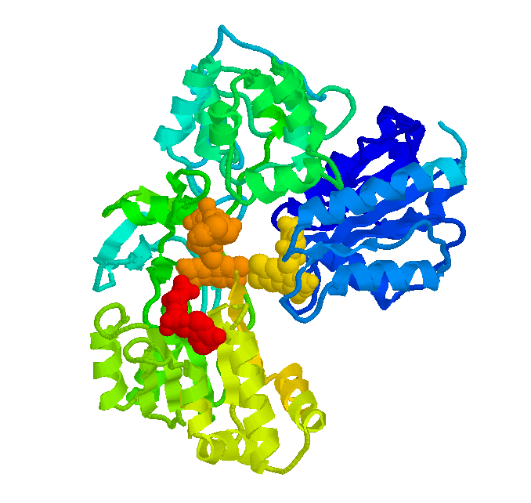
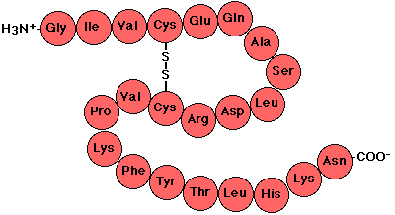
Protein
Pepsin in the stomach breaks the chain
Polypeptide Chain

Slide 31
Proteins are broken down into polypeptides which are smaller chains of amino acids linked together.
This is not the end product however as the polypeptide chain must become an amino acid, this occurs in the duodenum.

Slide 32
The duodenum is the first part of the gut known as the small intestine.
In the duodenum bile that is made in the liver and stored in the gall bladder.
Pancreatic juice is made by the pancreas. They are poured into the duodenum, Bile has sodium bicarbonate which neutralizes the acid from the stomach that makes the food acid.
The pH of the duodenum is now alkaline.
Pepsin and rennin cannot work here. Pepsin and rennin only work in acidic environments.

Slide 33
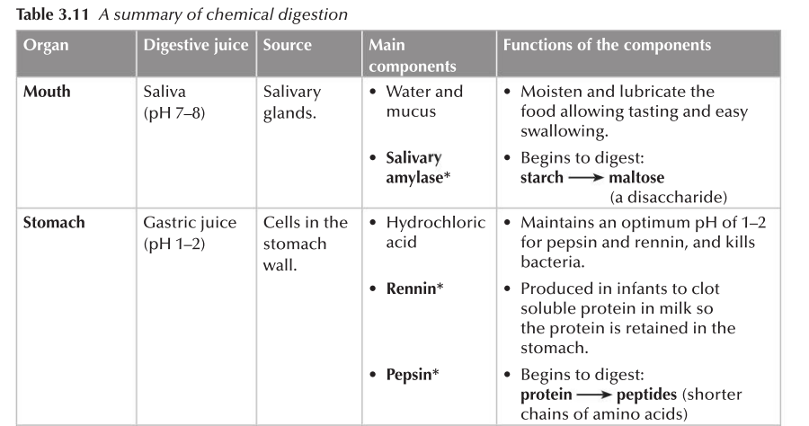
Source: Concise Revision Course: Human and Social Biology

Slide 34
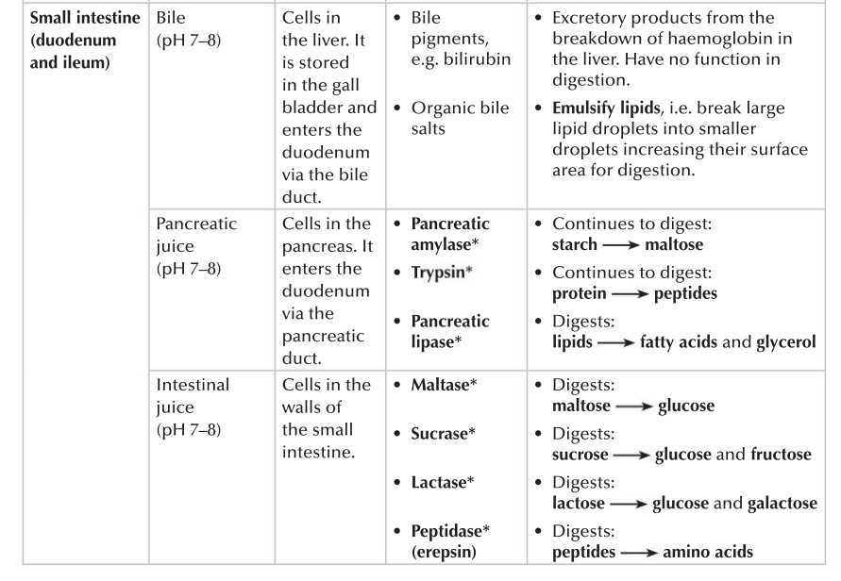
Source: Concise Revision Course: Human and Social Biology

Slide 35
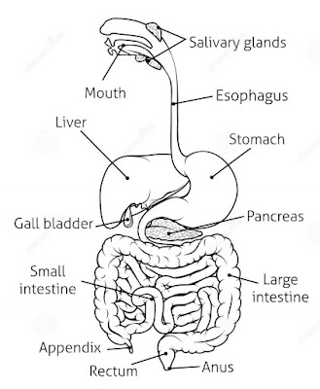
Parts of the Digestive System

Slide 36
State three parts of the Digestive system where chemical digestion takes place.

Slide 37
Lesson Sources:
Concise Revision Course - Human and Social Biology - a Concise Revision Course for CSEC®
Textbook by Anne Tindale and Shaun deSouza
Human & Social Biology for CSEC® Examinations 6th Edition Student's Book by Phil Gadd

