Slide 1

JOINTS AND MUSCLES

Slide 2
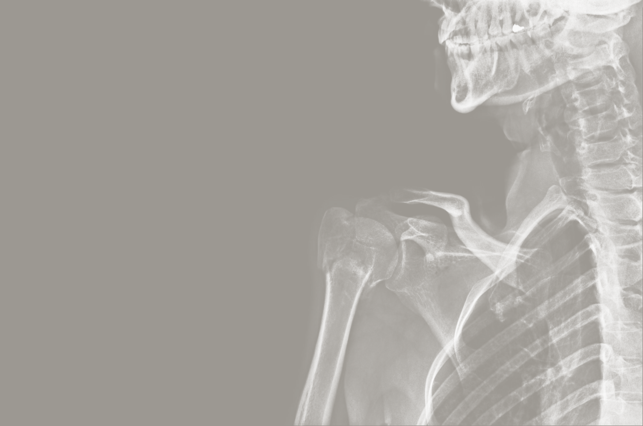
Lesson Objectives:
Discuss the types of joints.
Describe movement in the hinge and ball and socket joints.
Discuss the three types of muscles.
Explain how skeletal muscles function in the movement of a limb.
Explain how skeletal muscles function in the movement of a limb.
Explain the importance of locomotion to man

Slide 3
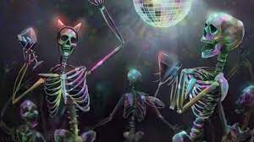
When two Skeletons decide to go to a party where do they meet?
A Joint!

Slide 4
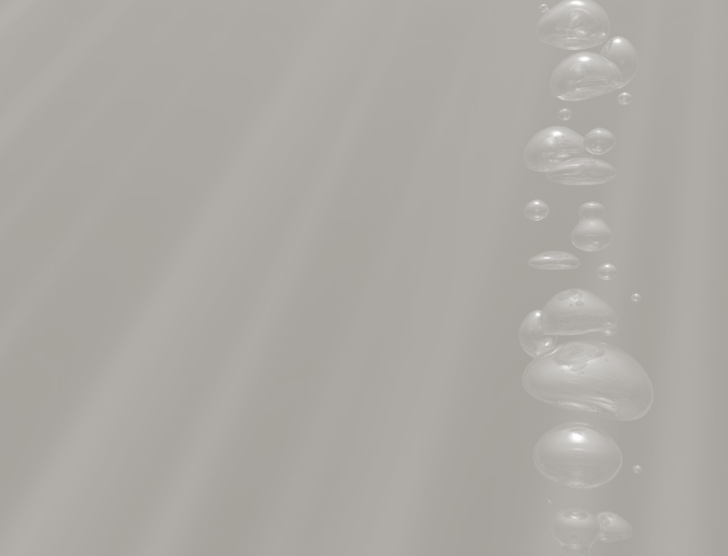
Joints

Slide 5

Joints
A joint is formed where two bones meet. Most joints allow the rigid skeleton to move.
There are three types of joints:
Fixed joints
Partially movable joints
Moveable joints

Slide 6
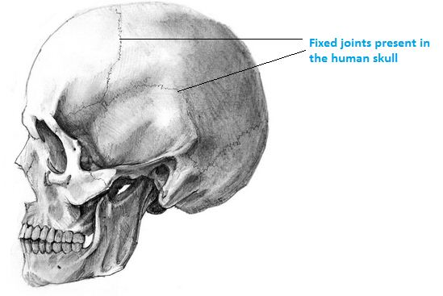
Fixed Joints
At a Fixed Joint the bones are joined firmly together by fibrous connective tissue which
allows no movement,
e.g. the cranium is
made of several
bones joined by
fixed or immovable
joints.

Slide 7
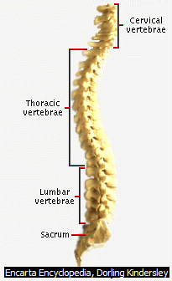
Partially Movable Joints
At a Partially Movable Joint the bones are separated by cartilage pads which allow slight movement, e.g. the vertebrae are separated by intervertebral discs of cartilage.

Slide 8
Moveable Joint
At Moveable joints or synovial joints the articulating surfaces of the bones are covered with articular
cartilage and synovial fluid fills the joint cavity between the bones. The bones are held together by
ligaments.
There are two types of moveable joints:
Hinge Joints
Ball and Socet Joints

Slide 9
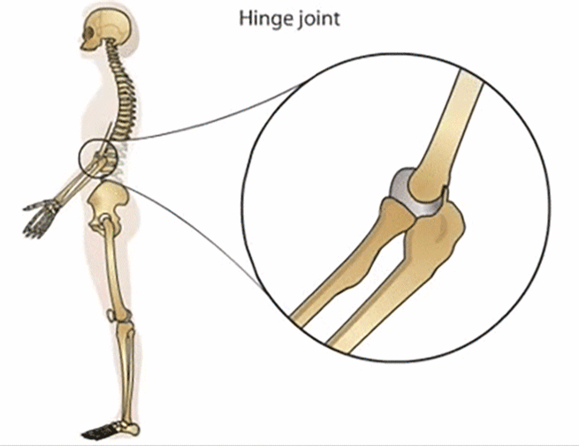
Hinge Joint
Hinge joints are formed when the ends of the bones meet. They allow movement in one plane (direction) only. This limited movement provides strength and the joints are capable of bearing heavy loads, e.g. the elbow, knee, finger and toe joints.

Slide 10

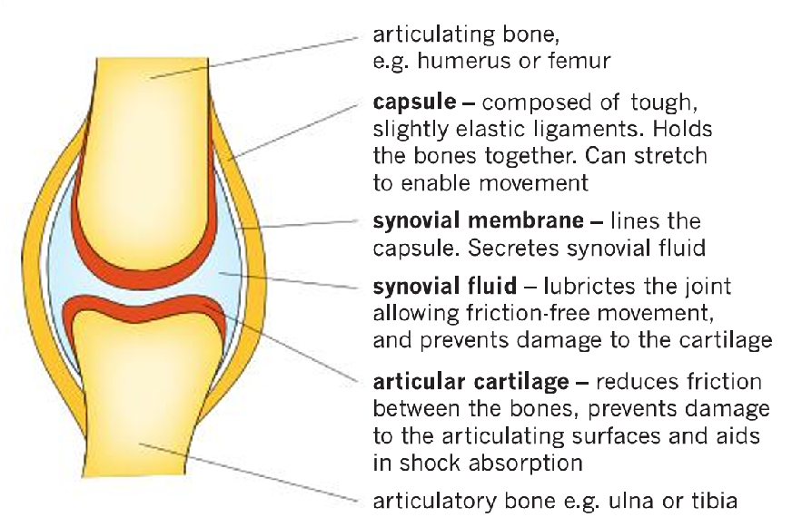
Structure and functions of the parts of a generalised hinge joint
Source: Concise Revision Course: Human and Social Biology

Slide 11
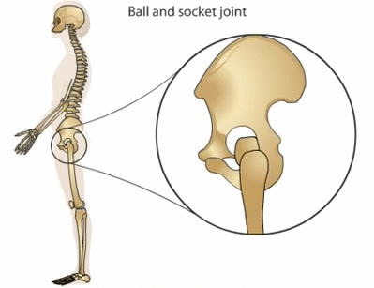
Ball and Socket Joints
Ball and socket joints are formed
where a ball at the end of one
bone fits into a socket in the
other bone. They allow rotational
movement in all planes. The free
range of movement provides less
support and makes the joints
more susceptible to dislocation
than a hinge joint, e.g. the
shoulder and hip joints.

Slide 12
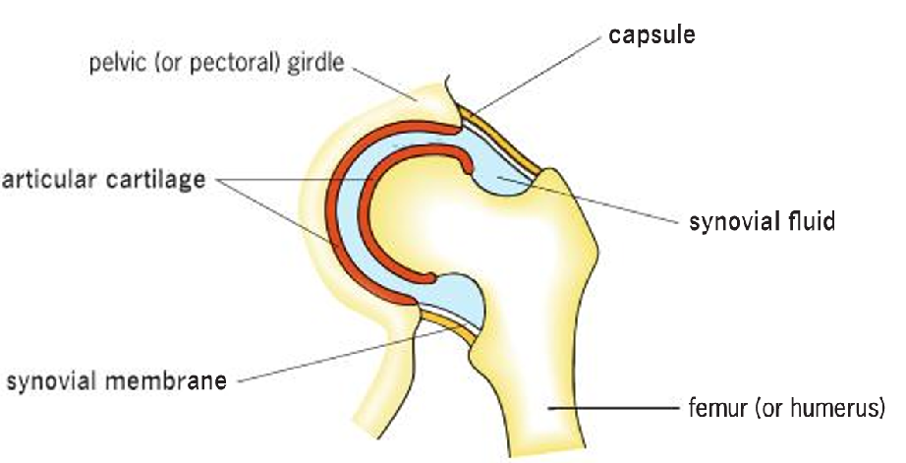
Structure of the parts of a ball and socket joint
Source: Concise Revision Course: Human and Social Biology

Slide 13

State the three types of joints and where they can be found in the human body.

Slide 14
Muscles

Slide 15
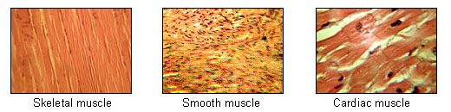
Muscles
Muscles are responsible for movement in the human body. Muscles can cause either locomotion of the organism itself or movement of internal organs.
There are three types of muscles:
Cardiac
Smooth
Skeletal

Slide 16
Muscles con’t
Cardiac and Smooth muscle contraction occurs without conscious thought and is necessary for survival.
Skeletal muscle is a form of striated muscle tissue existing under control of the somatic nervous system- i.e. it is voluntarily controlled.

Slide 17
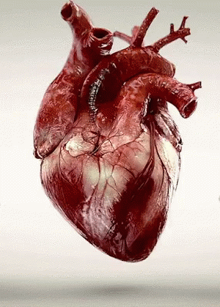
Cardiac Muscle
Cardiac muscle make up the walls of the human heart. Cardiac muscle is adapted to be highly resistant to fatigue: it has a large number of mitochondria, enabling continuous aerobic respiration via oxidative phosphorylation, numerous myoglobins (oxygen-storing pigment) and a good blood supply, which provides nutrients and oxygen.

Slide 18
Smooth Muscle
Smooth muscle is found in the walls of all the hollow organs of the body (except the heart). Its contraction reduces the size of these structures.
Regulates the flow of blood in the arteries
Moves your breakfast along through your gastrointestinal tract
Expels urine from your urinary bladder
Sends babies out into the world from the uterus
Regulates the flow of air through the lungs
The contraction of smooth muscle is generally not under voluntary control.

Slide 19
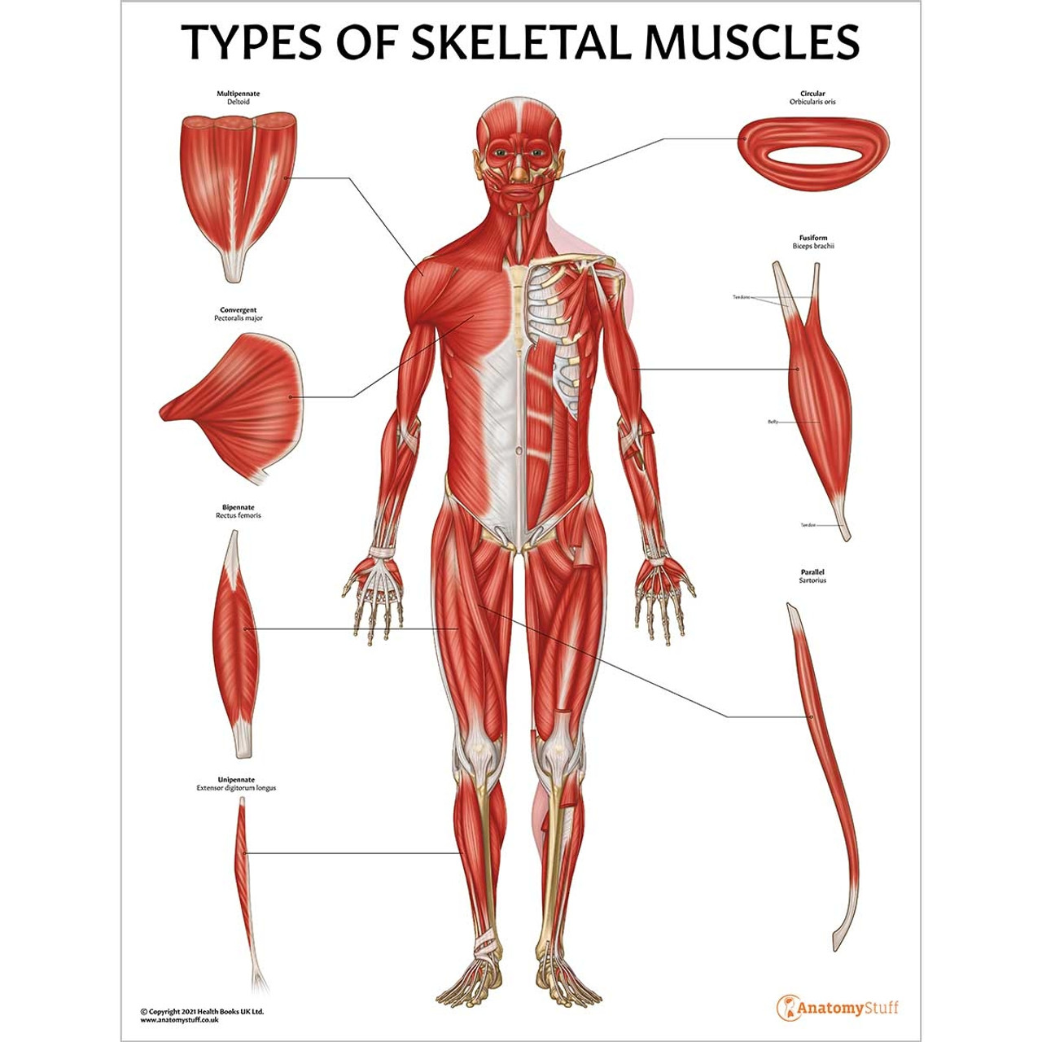
Skeletal Muscle
Skeletal muscles consist of bundles of multinucleate muscle fibres which are surrounded by connective tissue. Tendons attach these muscles to the bones of the skeleton.

Slide 20
Movement of a limb
When a muscle contracts it exerts a pull, but it cannot exert a push when it relaxes.
Therefore, two muscles, known as an antagonistic pair, are always needed to produce movement at a moveable joint:
• The flexor muscle is the muscle that bends the joint when it contracts.
• The extensor muscle is the muscle that straightens the joint when it contracts

Slide 21
Explain how an antagonistic pair of muscles work to move a limb?

Slide 22
Movement of the elbow joint
The biceps and triceps muscles move the radius and ulna causing the elbow joint to bend or straighten:
• The biceps is the flexor muscle. Its origin is on the scapula which does not move, and its insertion is on the radius close to the elbow joint.
• The triceps is the extensor muscle. Its origin is on the scapula and top of the humerus which do not move, and its insertion is on the ulna close to the elbow joint. To bend the elbow joint, the biceps contracts and the triceps relaxes. To straighten the elbow joint, the triceps contracts and the biceps relaxes.

Slide 23
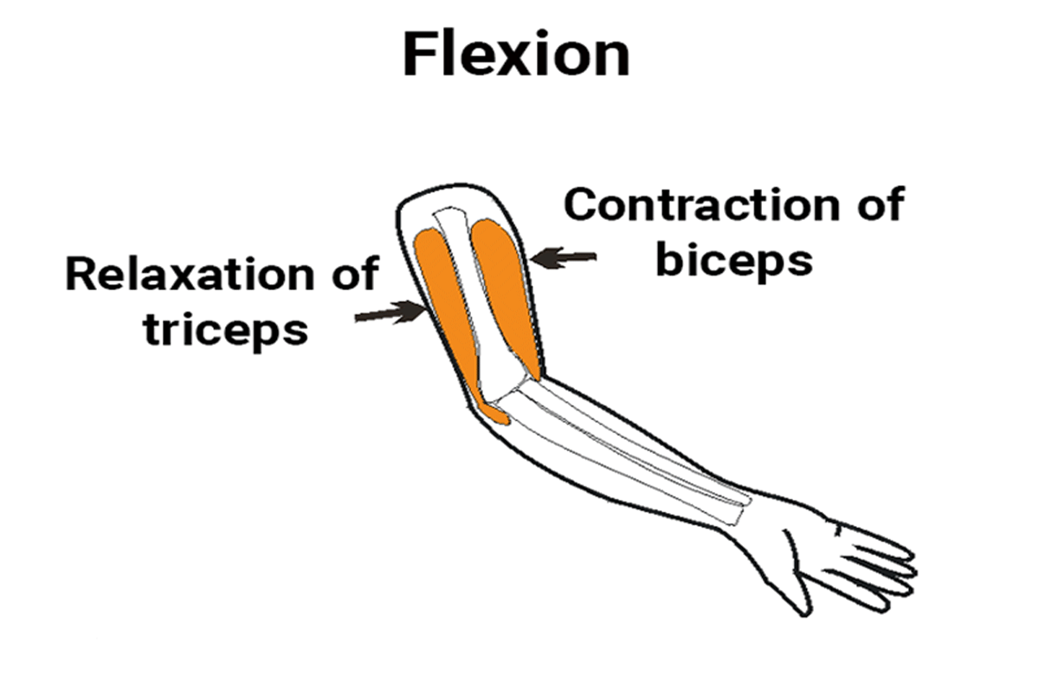
Gif: Contraction and Relaxation of Triceps and Biceps
Source: toppr.com/ask/content/story/amp/importance-of-muscles-in-movement-of-bones-124460/

Slide 24
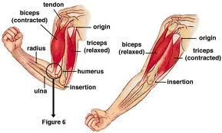
Diagram: Contraction and Relaxation of Triceps and Biceps

Slide 25
State three reasons why it’s important for humans to move (locomotion)

Slide 26
Lesson Review Questions:
What is a joint?
How does movement at a hinge joint differ from movement at a ball and socket joint?
Identify TWO places in the human body where you would find EACH type of joint named in 2. above.
Explain how muscles of the leg bring about bending and straightening of the knee joint.
Name the muscle that bends Jaden’s elbow joint and the muscle that straightens it.

Slide 27
Summary
A Joint is a place in the human body where two bones meet.
There are three types of joints: fixed, partially movable and moveable.
There are two types of moveable joints: the hinge joint and the ball and socket joint.
There are three types of muscles: cardiac, smooth and skeletal
Limbs move by the contraction and relating of antagonistic muscle pairs e.g. triceps and biceps.

Slide 28
Lesson Sources:
Concise Revision Course - Human and Social Biology - a Concise Revision Course for CSEC®
Textbook by Anne Tindale and Shaun deSouza
Human & Social Biology for CSEC® Examinations 6th Edition Student's Book by Phil Gadd

