Slide 1

Life Processes: Nutrition.

Slide 2
Lesson Objectives:
Distinguish between macro and micro nutrients and list their functions
State the cause, symptoms and treatment of deficiency diseases;
Discuss the importance of a balanced diet
Discuss the effects of malnutrition on the human body
Determine Body Mass Index

Slide 3
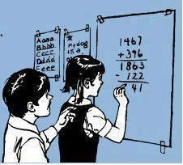
If Billy has 32 candy bars and he Eats 28, what does Billy have now?
Diabetes

Slide 4

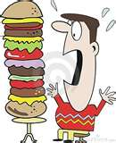
Definition
Nutrition is the process by which organisms make or obtain food.

Slide 5
Or Nutrition can be described as, the science of food the nutrients in food and how the body uses those nutrients. It includes the process of ingestion, digestion, absorption, metabolism, transport, storage and excretion of those nutrients.

Slide 6

How do we acquire food?

Slide 7
Definition
Diet is the food an organism eats on a continuous basis. In other words, the food we eat everyday.

Slide 8
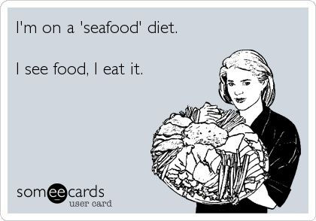

Slide 9

The human Diet must consist of the following:

Slide 10
Macronutrients: These are required in relatively large quantities.
Carbohydrates
Proteins
Lipids (Fats)

Slide 11
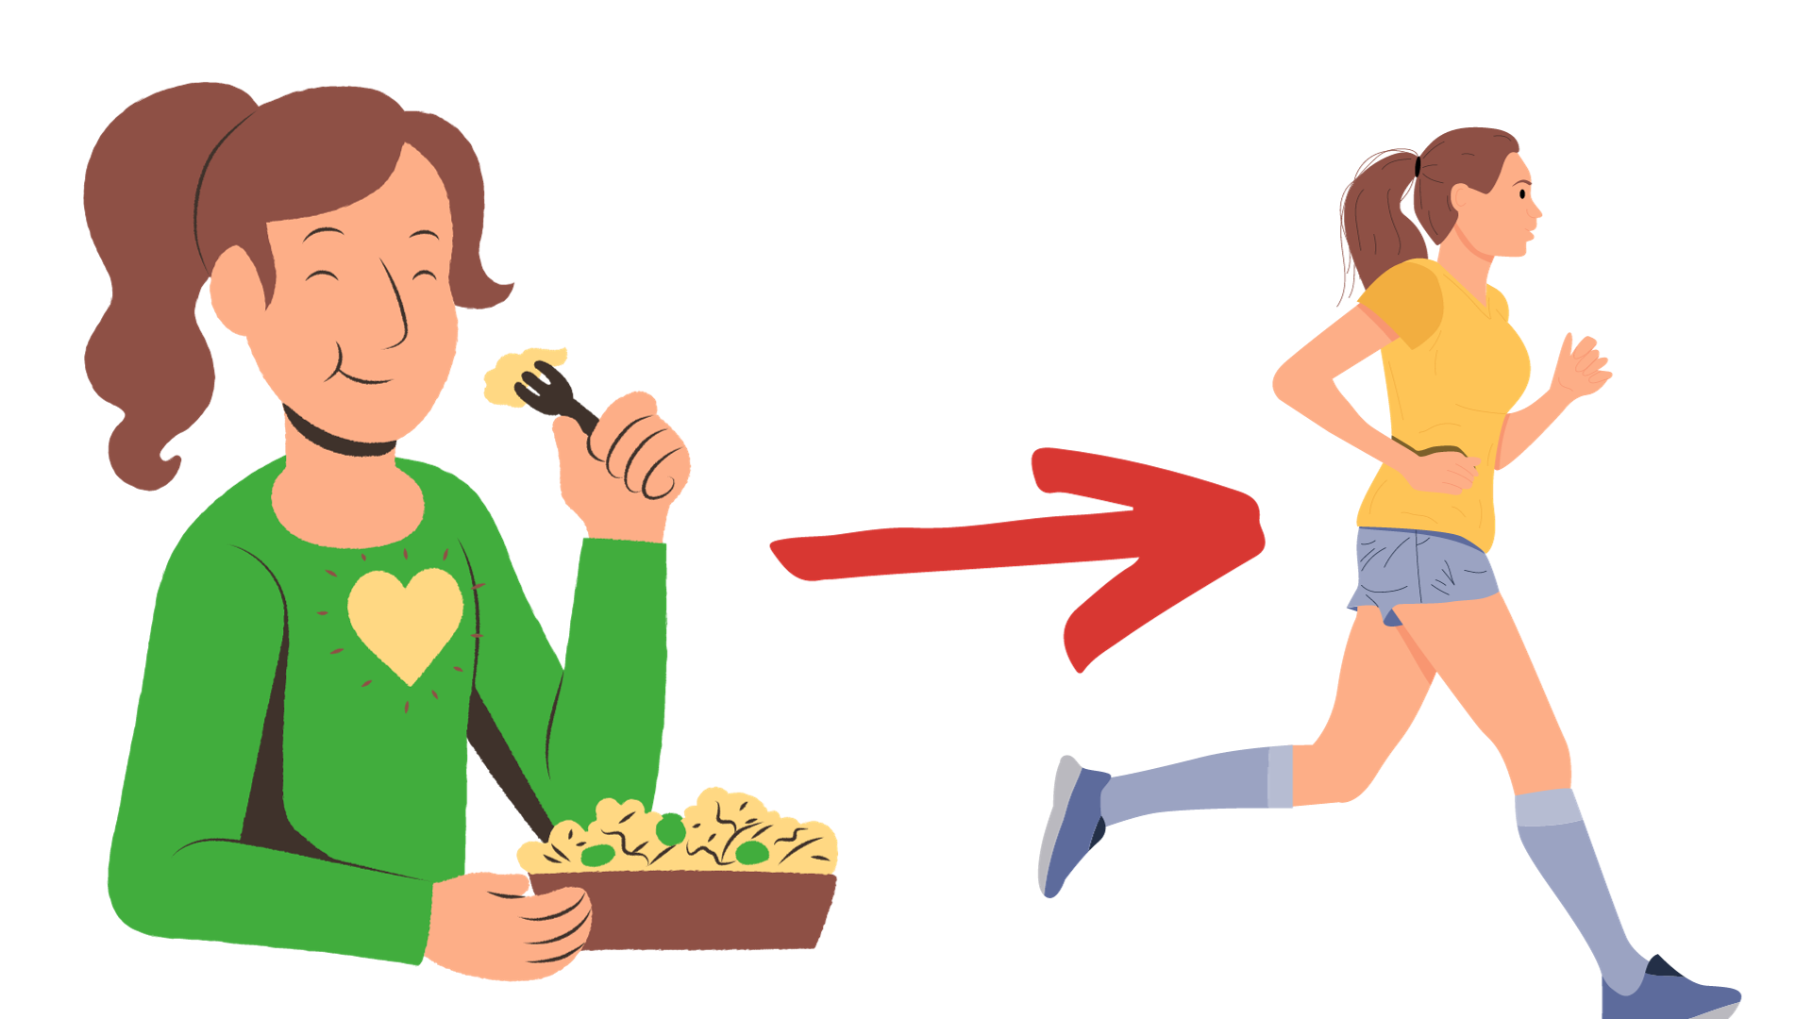
Carbohydrates
These are the foods that supply the most of our energy. Carbohydrates contains the elements carbon, hydrogen and oxygen.

Slide 12
Carbohydrates
Carbohydrates can be classified as:
(i) Monosaccharide or single sugar units . They are made up of the elements Carbon, Hydrogen and Oxygen. They include the sugars fructose glucose (C6H12O6) and galactose.
Another name for monosaccharide are – reducing sugars or simple sugars

Slide 13
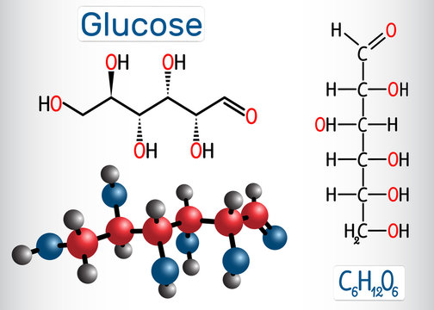
Source:https://stock.adobe.com/

Slide 14
Carbohydrates
(ii) Disaccharide – These are two monosaccharides linked together they are soluble and sweet. Used as a source of energy include maltose, sucrose (cane sugar ) and lactose (milk sugar).

Slide 15
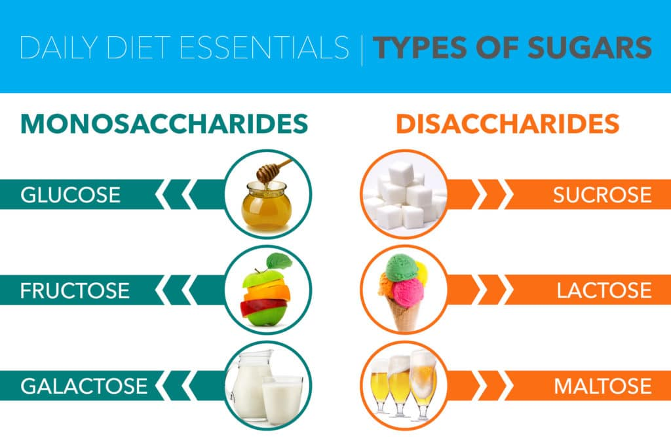
Source:http://fructosefacts.org/

Slide 16
Carbohydrates
(iii) Polysaccharides – These are made up of many simple sugar molecules joined together. They are insoluble they are used as energy storage compounds. They include starch and cellulose (in plants) and glycogen in animals.

Slide 17
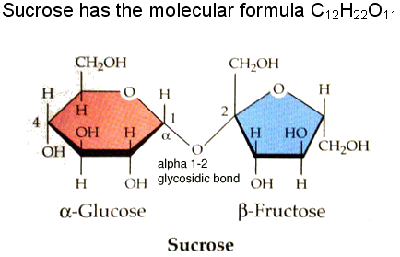

Slide 18
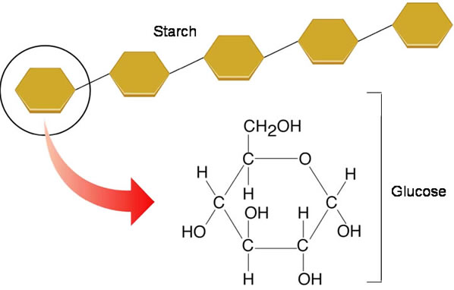
POLYSACCHARIDE MOLECULE

Slide 19
What are the three classifications of Carbohydrates?

Slide 20
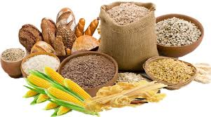
Sources of Carbohydrates
Bread
Cereal
Pasta
Rice
Potatoes
Yam
Sweet foods

Slide 21
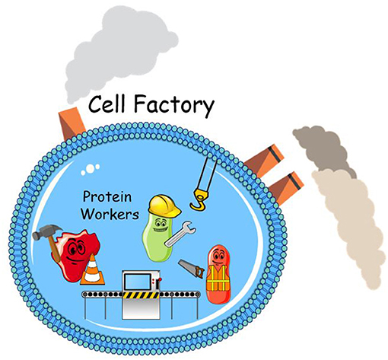
Proteins
Proteins are used to repair cells and for growth of new cells.
Proteins are molecules made up of long chains of amino acids, these amino acids are held together by peptide bonds. Amino acids are the basic building blocks of proteins.
Source: https://kids.frontiersin.org/

Slide 22

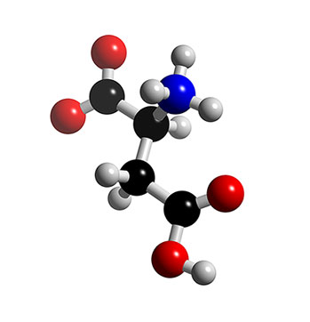
Proteins are also used as a Energy back up, if Carbohydrates aren’t available.
Amino Acid Molecule.

Slide 23
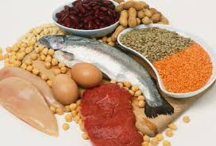
Sources of Protein
Meat
Fish
Milk
Eggs
Cheese
Peas
Beans

Slide 24
Lipids (fats)
Their main function include energy storage and as components of cell membranes. Lipids constitute a broad group of naturally occurring molecules that include fats, waxes, sterols. Some dietary fat is also necessary to facilitate the absorption of fat soluble vitamins A, D, E and K.

Slide 25
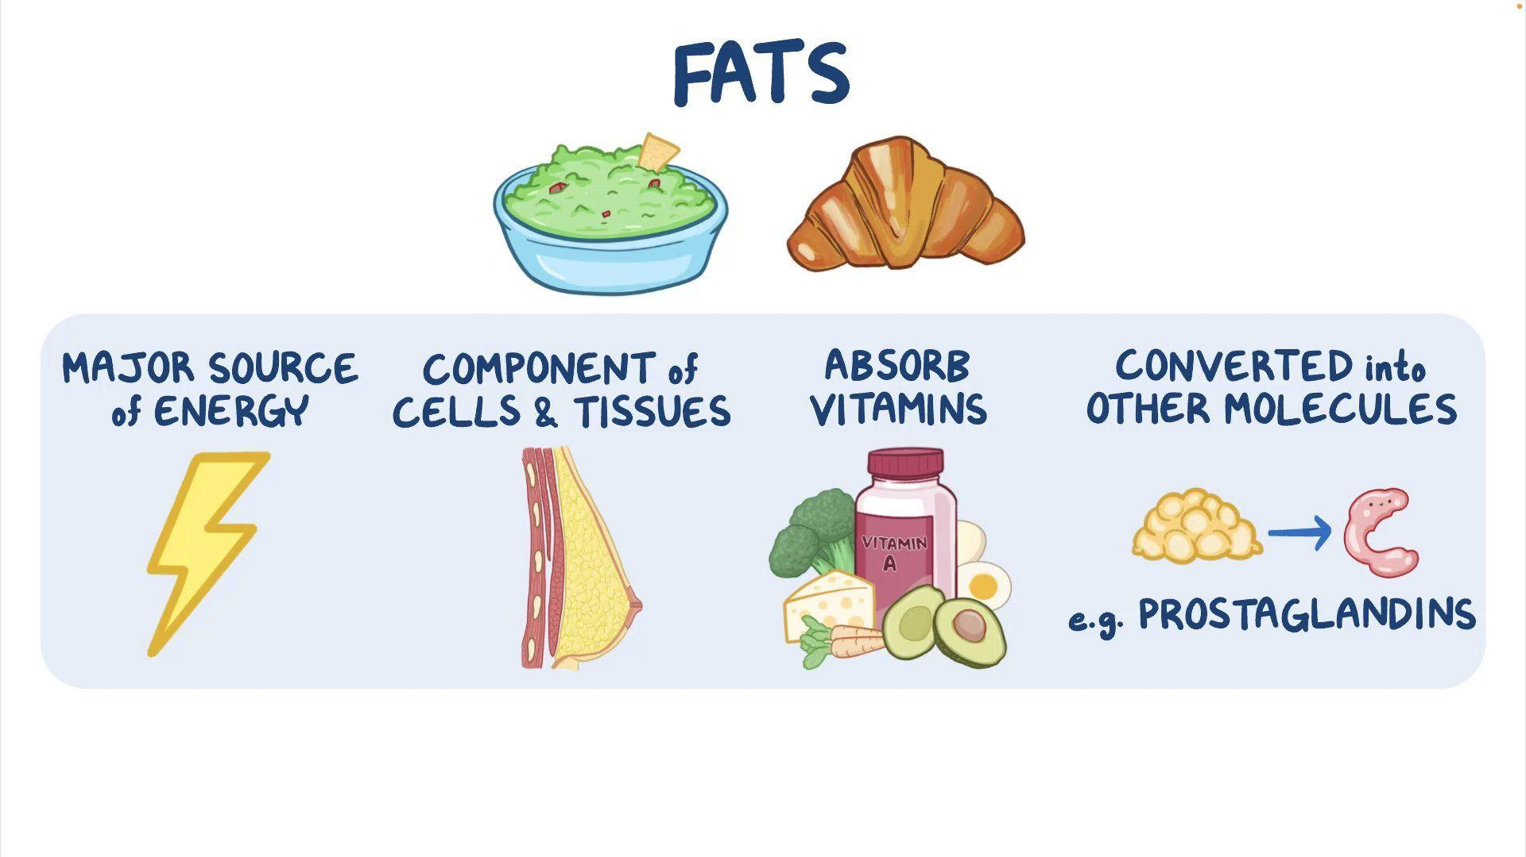

Slide 26
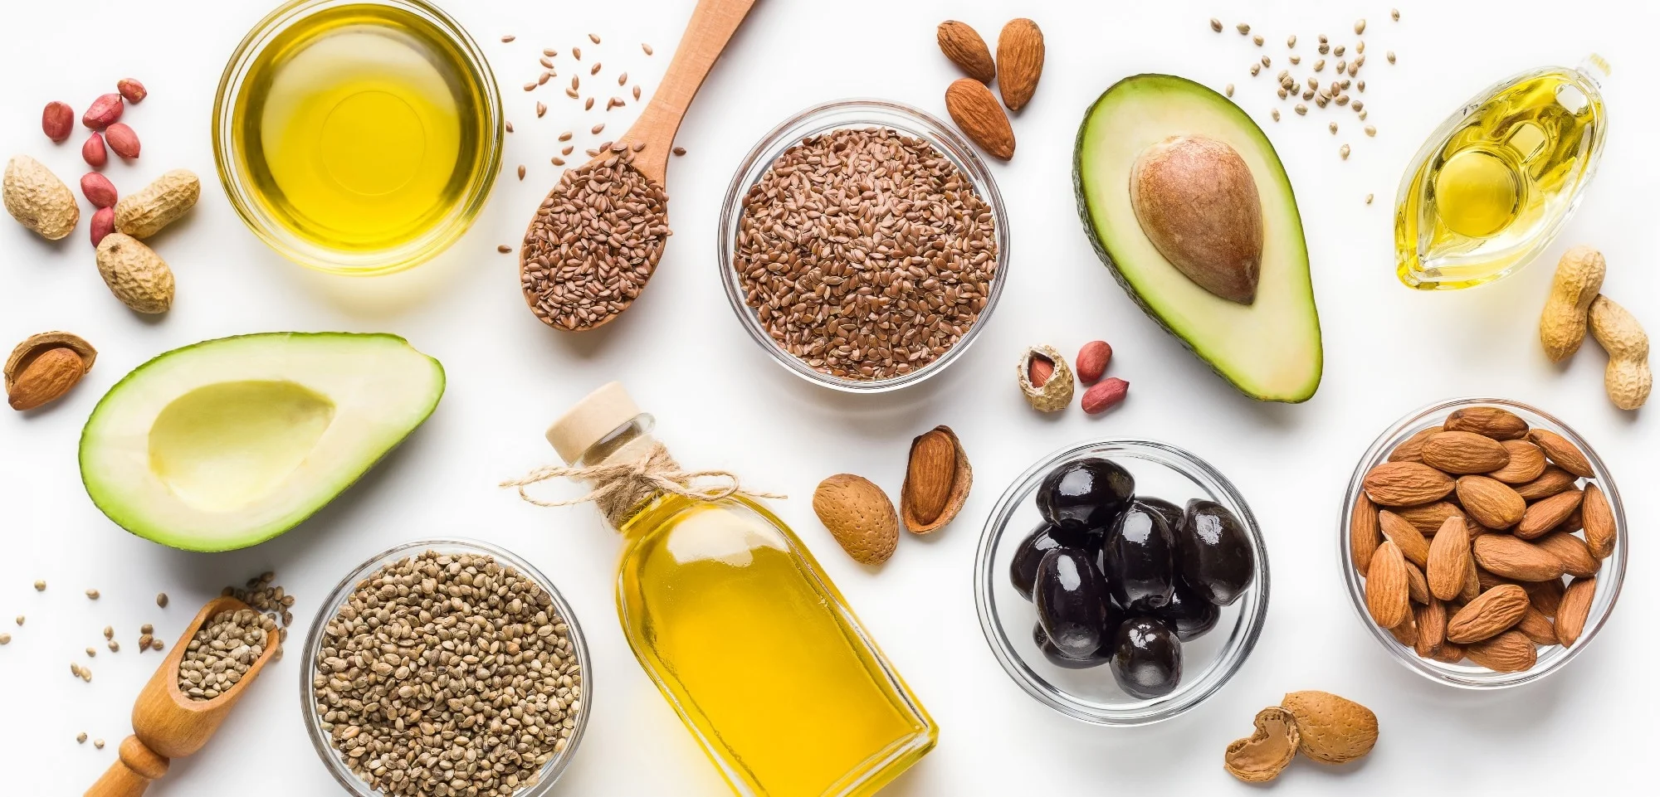
Sources of Lipids (fats)
Butter
Vegetable oils
margarine
Nuts
Fatty meats
Avocado

Slide 27
Jane is preparing to run a marathon, which of the following items would provide Jane the most energy for the before race?
A Fruit Salad
Eggs and sausage
Plain toast
Oatmeal

Slide 28
Micronutrients: These are required in relatively small quantities.
Vitamins
Minerals

Slide 29
Vitamins
These are organic compounds required as a vital nutrient in tiny amounts by an organism.

Slide 30
Vitamin | Sources | Function | Symptoms of deficiency
A | Liver, cod liver oil, yellow and orange vegetables and fruits, e.g. carrots and pumpkin, green leafy vegetables, e.g. spinach | Helps to keep the skin, cornea and mucous membranes healthy. Helps vision in dim light (night vision). Strengthens the immune system | Night Blindness Poor vision in dim light. Vision adapts slowly between bright and dim conditions.
B1 | Whole-grain cereals and bread, brown rice, peas, beans, nuts, yeast extract, lean pork | Aids in respiration to produce energy. Important for the proper functioning of the nervous system. | Beriberi: Loss of muscle function or paralysis of the lower legs. Speech difficulties. Mental confusion.

Slide 31
Vitamin | Sources | Function | Symptoms of deficiency
C | Citrus, fruits, Barbados cherry, raw green vegetables | Keeps tissues healthy, especially skin and connective tissue | Scurvy: Bleeding from gums and other membranes, loss of teeth wounds do not heal painful muscles and joints
D | Animal fats, Manufactured in the body by action of sunlight on skin | Aids absorption of calcium and phosphorus from ileum, important in formation of bones and teeth | Rickets: soft, weak bones, with swollen ends especially, leg bones bow legs, Poor teeth
K | Liver, green vegetables. | Aids in blood clotting | Prolonged bleeding when out, Blood fails to clot easily.

Slide 32
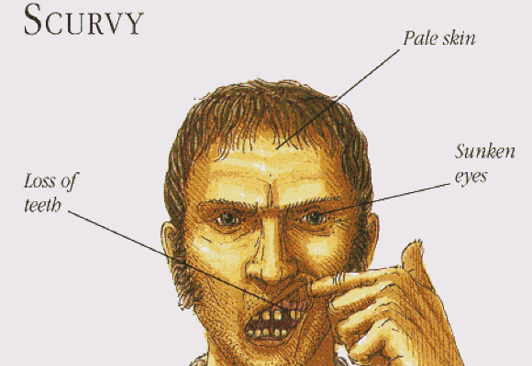
Pirates often suffered from Scurvy, due to the lack of availability to fresh fruits while at sea.

Slide 33
Minerals
Required in small amounts for healthy growth and development.

Slide 34
Mineral | Sources | Functions | Symptoms of deficiency
Calcium (Ca) | Milk, cheese | Formation of bones and teeth. Aids in blood clotting | Brittle bones and teeth. Possible causes rickets
Iron (Fe) | Liver, kidney, red meat, egg yolk, green leafy vegetables | Formation of haemoglobin | Anaemia: reduction in number of red blood cells, tiredness, lack of energy

Slide 35
Mineral | Sources | Functions | Symptoms of deficiency
Sodium (Na) Potassium (K) Chlorine (Cl) | Table salt Meat, vegetables, banana Table salt | Transmission of nerve impulses and muscle contraction maintenance of correct concentration of body fluids | Muscular cramps
Fluorine (F) | Fluorinated tap water, fluoride toothpaste | Increases resistance to tooth enamel to decay | More rapid tooth decay

Slide 36
Mineral | Sources | Functions | Symptoms of deficiency
Iodine (I) | Sea foods, iodised table salt | Formation of thyroxine | Goitre in adults swelling of thyroid gland in neck, reduced metabolic rate

Slide 37
State three vitamins, three minerals and their deficiencies.

Slide 38
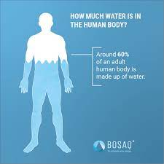
Water
Water is essential in the diet since the human body is about 60% water.

Slide 39
Functions of Water
Water acts as a solvent to dissolve chemicals in cells so that they can react.
Water acts as a solvent to dissolve waste substances so that they can be excreted from the body, e.g. urine contains dissolved urea.
Water acts as a coolant, removing heat from the body when it evaporates from sweat.

Slide 40

Dietary Fibre
Dietary fibre is food that cannot be digested. Dietary fibre adds bulk to the food which stimulates peristalsis so that food is kept moving through the digestive system.
This helps prevent constipation and reduces the
risk of colorectal (bowel) cancer.

Slide 41

Sources of Dietary Fibre
Beans
Whole grains
Brown rice
Nuts
Berries
Bran cereal
Oatmeal
Vegetables

Slide 42
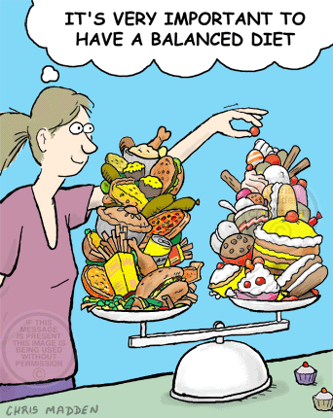
Balanced Diet

Slide 43
Can a balanced diet look differently for different people?

Slide 44
Balanced Diet
Humans must consume a balanced diet each day. This must contain carbohydrates, proteins, lipids, vitamins, minerals, water and dietary
fibre in the correct proportions to supply the body with enough energy for daily
activities and the correct materials for growth and development, and to keep the
body in a healthy state.

Slide 45
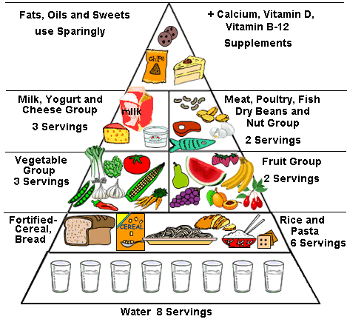
Food Pyramid

Slide 46
Assignment
Keri is 4 months pregnant, create a 3-day meal plan (breakfast, lunch and dinner) for Keri.

Slide 47
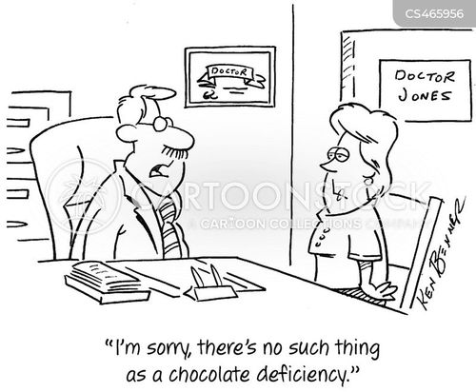
Malnutrition

Slide 48
Malnutrition
Malnutrition is defined as the condition that results from taking an unbalanced diet in which certain nutrients are lacking or are in excess.
i.e. over and under malnutrition.

Slide 49
Protein deficiency diseases include:
Marasmus – A disease caused by a severe deficiency of protein. It affects infants and young children. People with marasmus appear bony with little muscle tissue. (Deficiency diseases linked to carbohydrate deficiency can also be marasmus)

Slide 50
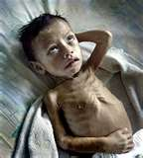
Child suffering from Marasmus

Slide 51
Kwashiorkor – Severe deficiency of protein in diets that contain mostly calories from carbohydrates. It affects older children. Symptoms are a puffy abdomen from the retention of fluid, fatigue, stunted growth, diarrhea and impaired mental health.

Slide 52

A child suffering from Kwashiorkor

Slide 53
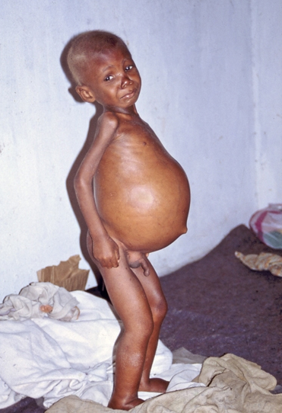
Child Suffering from Kwashiorkor

Slide 54
Beriberi is a nervous system
ailment caused by a thiamine
(vitamin B₁) deficiency in the diet.

Slide 55
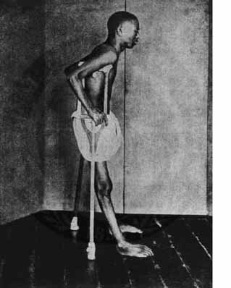
Person suffering from - Beriberi

Slide 56
Anemia: This condition develops when there are not enough healthy red blood cells to carry oxygen to the body tissues.
The types of anemia are related to the shape of the blood cells, levels of iron in the blood diet, nutrient deficiency and underlying medical problems.

Slide 57
Obesity is a medical condition in which excess body fat has accumulated to the extent that it may have an adverse effect on health, leading to reduced life expectancy and/or increased health problems.

Slide 58
For adults, overweight and obesity ranges are determined by using weight and height to calculate a number called the "body mass index" (BMI). BMI is used because, for most people, it correlates with their amount of body fat.
An adult who has a BMI between 25 and 29.9 is considered overweight.
An adult who has a BMI of 30 or higher is considered obese.

Slide 59
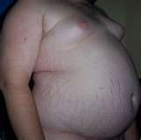

Slide 60
Anorexia Nervosa, mental illness in which a person has an intense fear of gaining weight and a distorted perception of their weight and body shape.
People with this illness believe themselves to be fat even when their weight is so low that their health is in danger. A person with anorexia nervosa severely restricts food intake and usually becomes extremely thin.

Slide 61
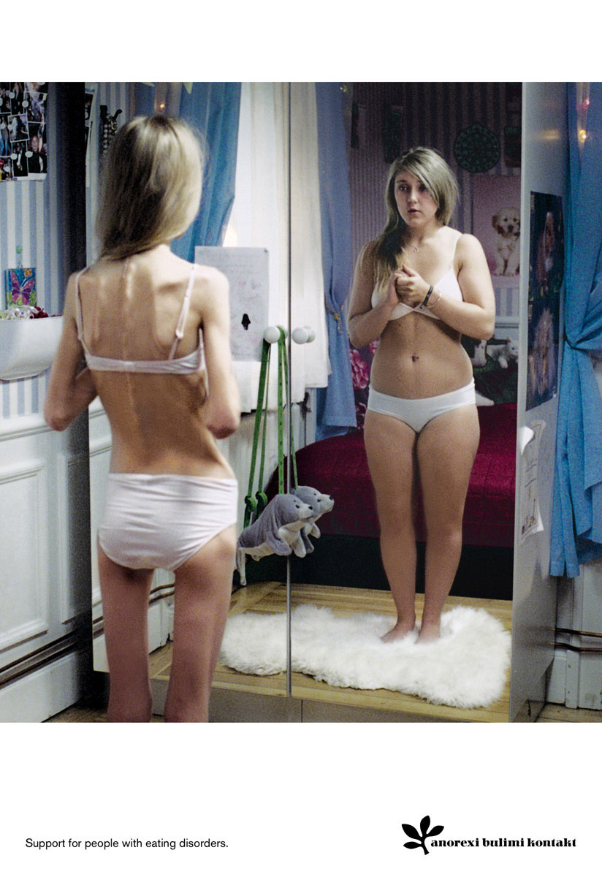

Slide 62
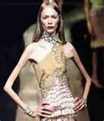

Slide 63
Effects Of Anorexia:
Undernourishment usually causes females with anorexia nervosa to stop menstruating.
* Dry yellow skin, brittle hair, change in the function of the kidney, gastrointestinal disorders, osteoporosis (loss of bone mass), changes in the function of the heart, low blood pressure, dizziness, fainting.

Slide 64
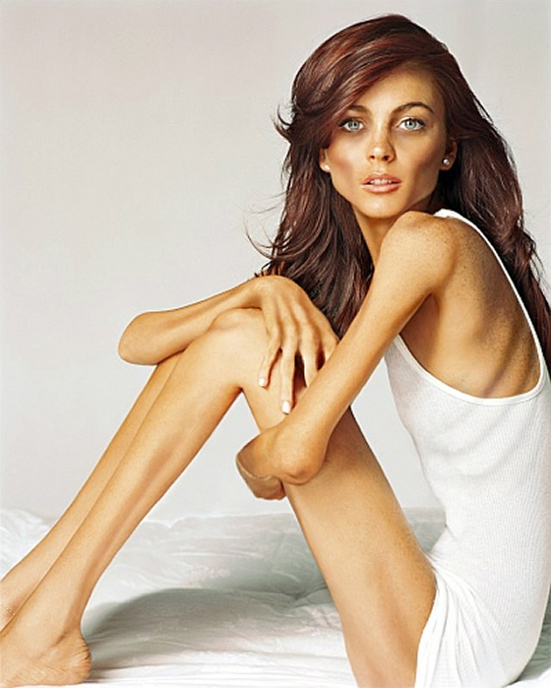

Slide 65
Bulimia
This is an eating disorder in which persistent concern about body weight and shape leads to repeated episodes of binging (consuming large amounts of food in a short time) associated with induced vomiting, use of laxatives, fasting and or excessive exercise.

Slide 66
Bulimia may directly cause a whole host of medical complications.
These are – gastric reflux, dehydration, oral trauma, constipation, infertility, peptic ulcers, severe dental erosion and swollen salivary glands.

Slide 67
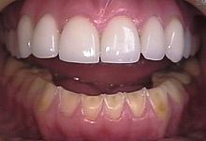
Erosion of the lower teeth caused by Bulimia. The upper teeth have been restored with porcelain veneers.

Slide 68
Consider the following Situations
A fifteen year old girl with anorexia.
A twenty year old football player with Aneamia
A 5 year old girl with obesity
A nine year old boy who doesn’t like vegetables
A sixteen year old girl who has goitre.

Slide 69
Answer the following questions for the situations on the previous slide
What is the Disease?
What are the symptoms and signs of the disease?
How did the individual get the disease?
How does the disease mentally affect the individual?
How does the disease affect the individual’s social life?
What is a possible treatment for the disease?

Slide 70

DON’T FORGET YOUR ASSIGNMENT!!

Slide 71
Lesson Sources:
Concise Revision Course - Human and Social Biology - a Concise Revision Course for CSEC®
Textbook by Anne Tindale and Shaun deSouza
Human & Social Biology for CSEC® Examinations 6th Edition Student's Book by Phil Gadd

