Slide 1
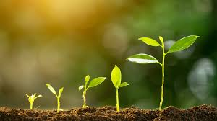
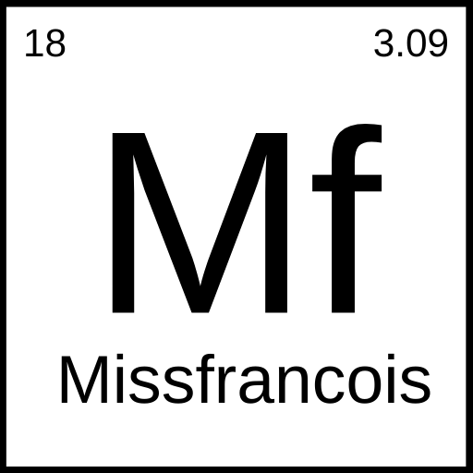
Photosynthesis.
missfrancois.com

Slide 2
Lesson Objectives:
Define Photosynthesis
Outline the process of photosynthesis
Identify the products of photosynthesis

Slide 3
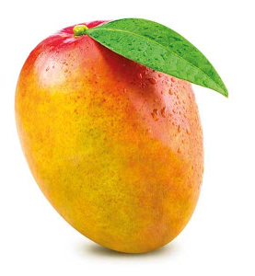
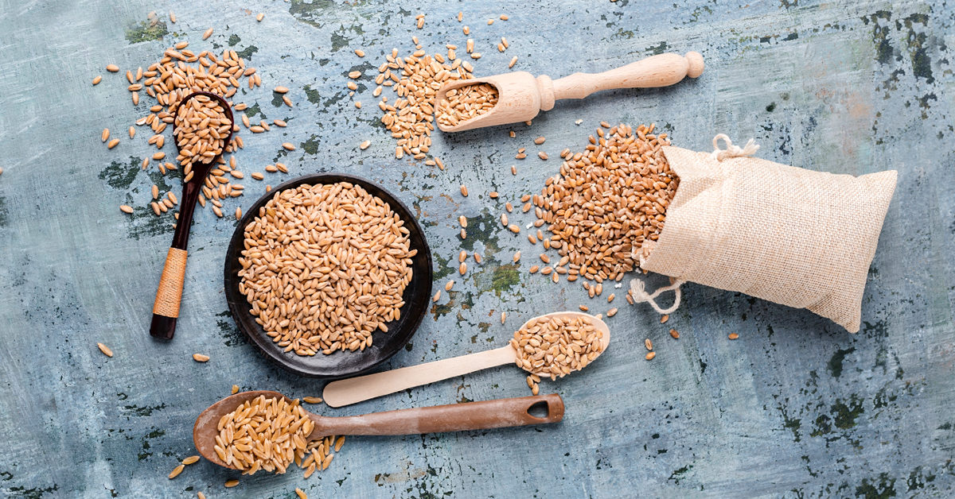
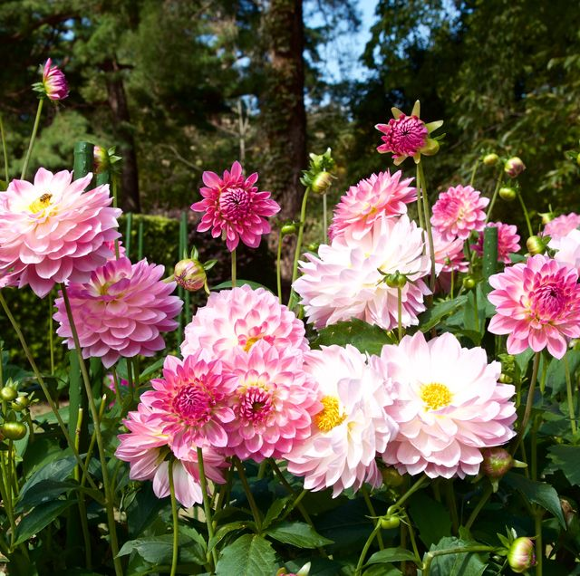
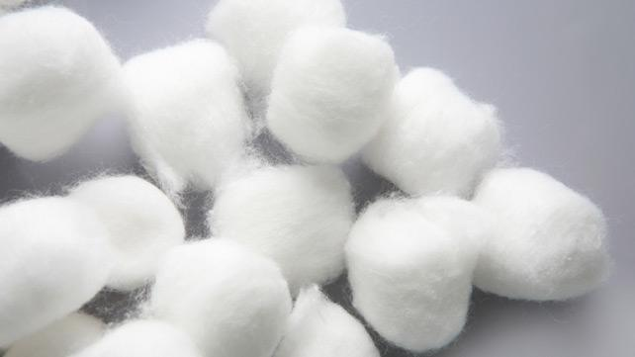
What do these things have common?
1
2
4
3

Slide 4


How do plants grow?

Slide 5

Definition
Photosynthesis is the process by which green plants and some other organisms use sunlight energy to convert carbon dioxide and water into glucose and oxygen.

Slide 6

What is needed for Photosynthesis?

Slide 7
Materials needed for Photosynthesis
Sunlight
Water
Carbon Dioxide
Magic ingredient

Slide 8

What are the products from Photosynthesis?

Slide 9
Products from Photosynthesis
Oxygen
Glucose (sugar)

Slide 10

Why can’t humans Photosynthesis?

Slide 11
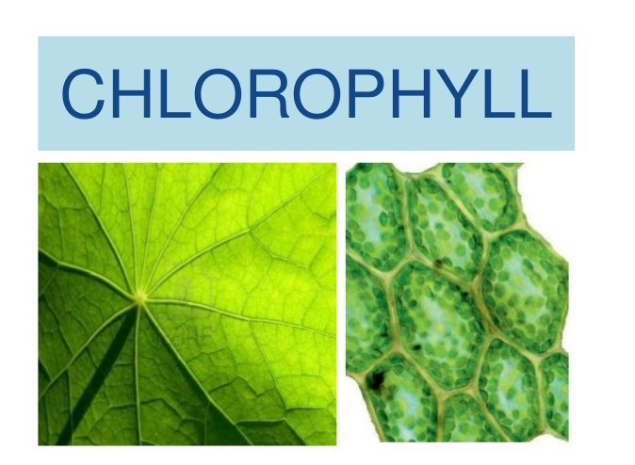
The magic ingredient!

Slide 12
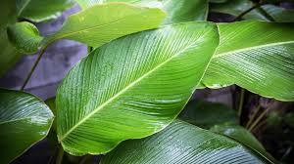
The role of chlorophyll in Photosynthesis
The green pigment chlorophyll is the most common pigment in plants..
Chlorophyll can trap some of the light that strikes it and use the energy that light contains to break the molecules of water and carbon dioxide apart to make glucose.

Slide 13

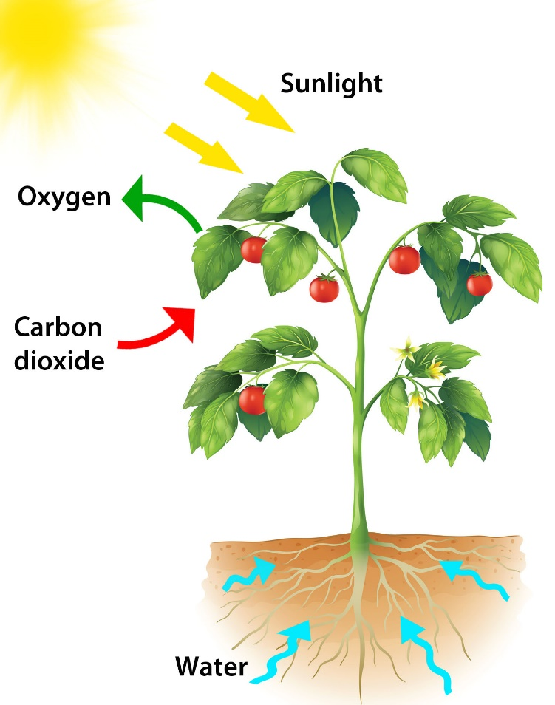
Word Equation
Sunlight
Carbon Dioxide + Water ---------🡪 Glucose + Oxygen
Chlorophyll
missfrancois.com

Slide 14
Materials needed for Photosynthesis
Sunlight
Water
Carbon Dioxide
Chlorophyll

Slide 15
Summary
Photosynthesis is the process by which green plants and some other organisms use sunlight energy to convert carbon dioxide and water into glucose and oxygen.
Word equation for Photosynthesis: Carbon Dioxide + Water ---------🡪 Glucose + Oxygen
Chlorophyll is found in the leaf of the plant and is where photosynthesis takes plant.
Glucose and oxygen are the two end products of photosynthesis.
Sunlight
Chlorophyll

Slide 16
Next Time in Science Class….
Who would win in a fight a lion or a bear?
Next lesson ‘Food Chains and Food Webs’

Slide 17

DON’T FORGET YOUR ASSIGNMENT!!

Slide 18
Lesson Sources:
Concise Revision Course - Human and Social Biology - a Concise Revision Course for CSEC®
Textbook by Anne Tindale and Shaun deSouza
Human & Social Biology for CSEC® Examinations 6th Edition Student's Book by Phil Gadd

